Slide 1

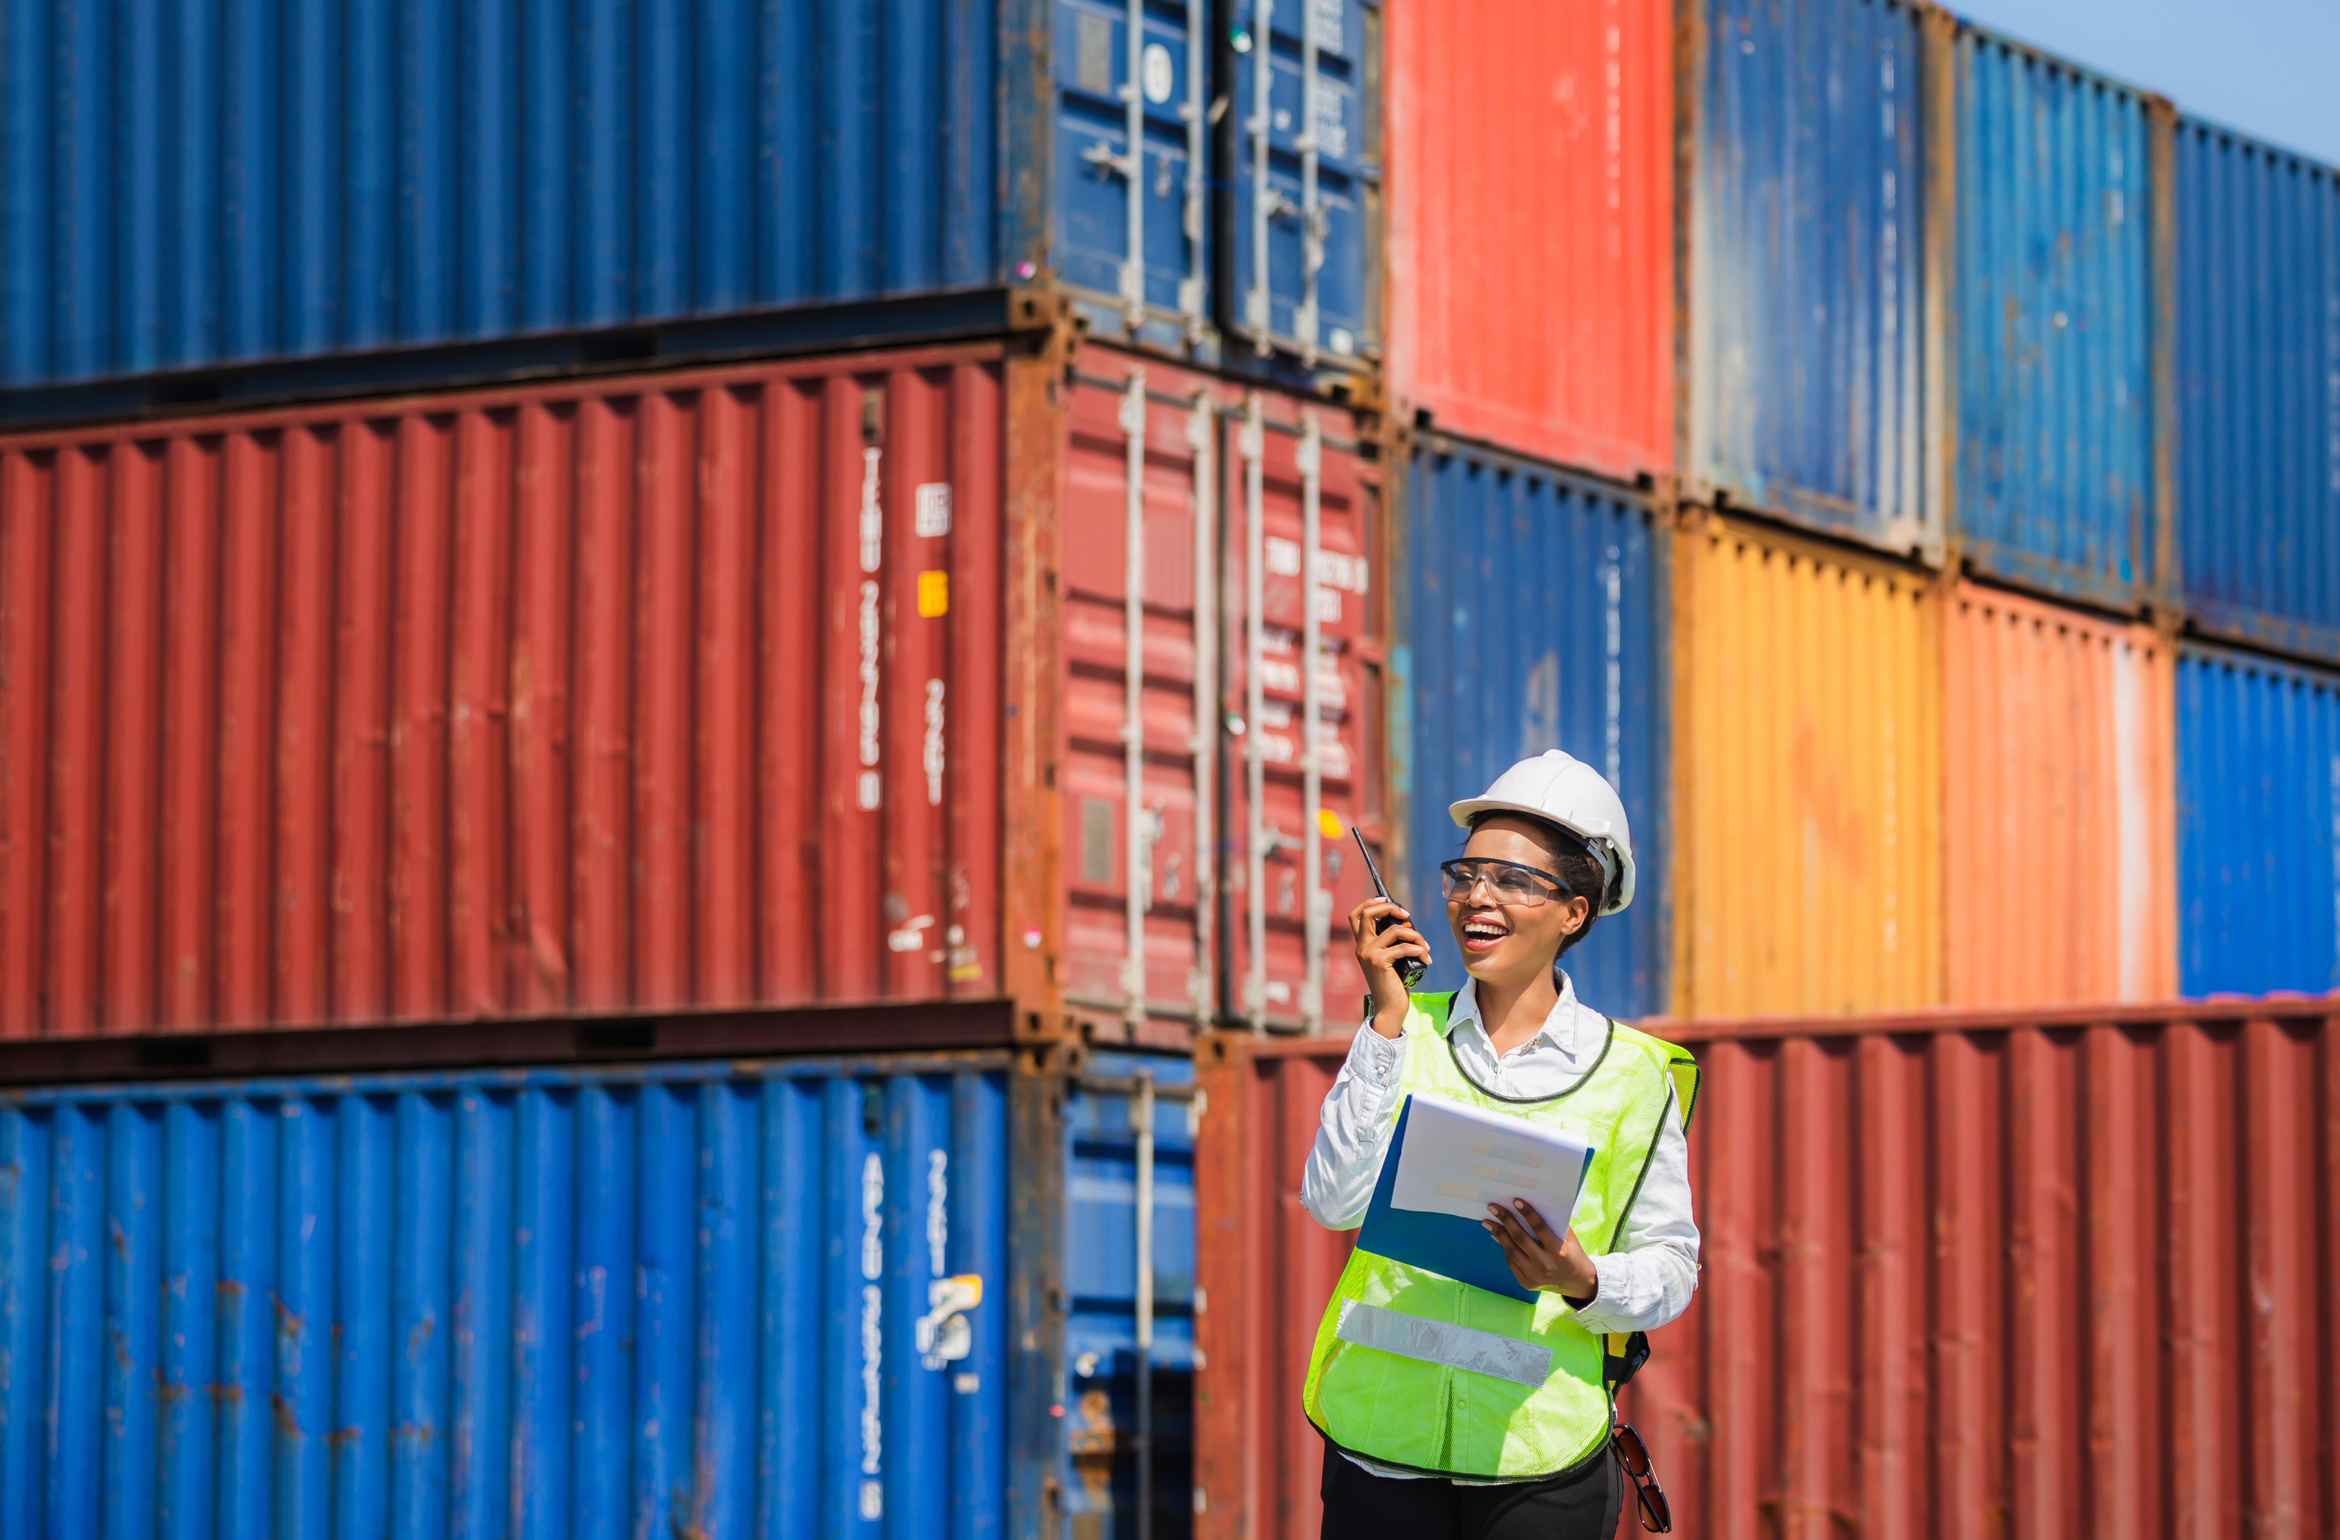
SESSION 6
Let’s
Be Safe

Slide 2
Guiding Questions
Could you build ways to transport cargo across water?
How do you create safer ways to transport cargo?
Outcomes
The team will design ways to safely transport cargo over water.
The team will add a safety feature to the sorting center.
How do you change the program to flash a blinking light?
Can you add a sensor to the sorting center and code it?
Notes:
Each session has Guiding Questions that can be shared to frame the session.​
Session Tips
Give the team the LEGO® prototyping pieces (Bag 4) to create their designs.
Provide specific examples of safety features found in your community. This could include cargo unloading zones and railroad crossing guards.
The team will apply the coding concept of light blocks learned in Session 3.
The team can look at the Career Connection page for ideas or research what this job does.

Slide 3



Introduction – Have an Impact
Examples of Impact
Ask the students to provide examples of Impact and record them here
Example of Impact
Example of Impact
We applied what we learned to improve our world.
Extension
Notes:
Introduction (10 minutes)
Have an Impact
Read the definition for impact to the team. (see page 5)
Talk about what impact is. Have the team provide examples of this Core Value.
Extension: Have everyone draw a picture of an example of impact on the Core Values page in their Engineering Notebook.

Slide 4

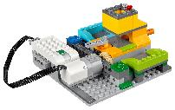
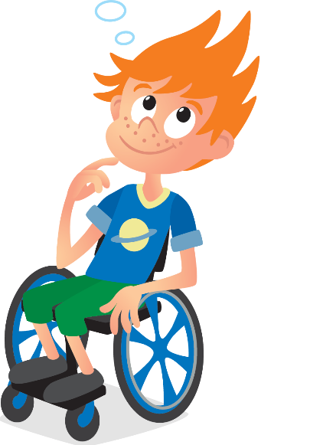
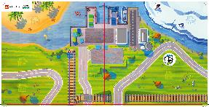
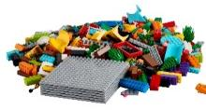
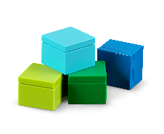
Task 1
You need…
What safety features are there on the sorting center and the mat?
How is cargo from your community transported safely across the water?
Notes:
Tasks (20 minutes)
Start with Ruby and Jacob’s questions while looking at the mat.
Design how you would transport cargo by air and water.
Show your team your innovative creation!
Create your team’s designs using the prototyping pieces.
Place your solutions on the mat.
Show how they will transport cargo safely from the sorting center to the island and icy area.

Slide 5
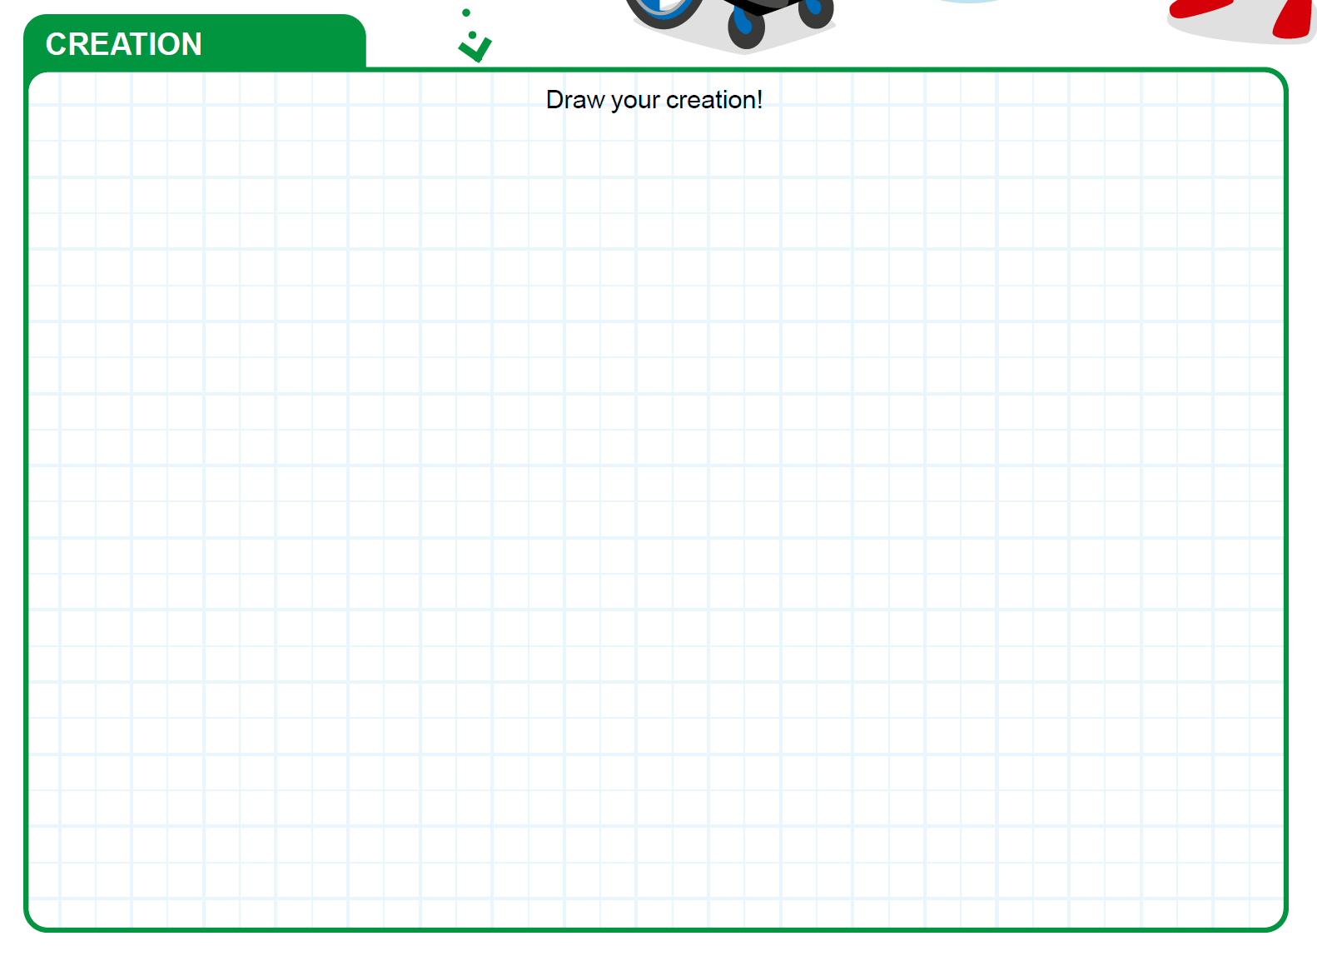
Task 1
Design how you would transport cargo by air and water.
Notes:
Tasks (20 minutes)
Start with Ruby and Jacob’s questions while looking at the mat.
Design how you would transport cargo by air and water.
Show your team your innovative creation!
Create your team’s designs using the prototyping pieces.
Place your solutions on the mat.
Show how they will transport cargo safely from the sorting center to the island and icy area.

Slide 6
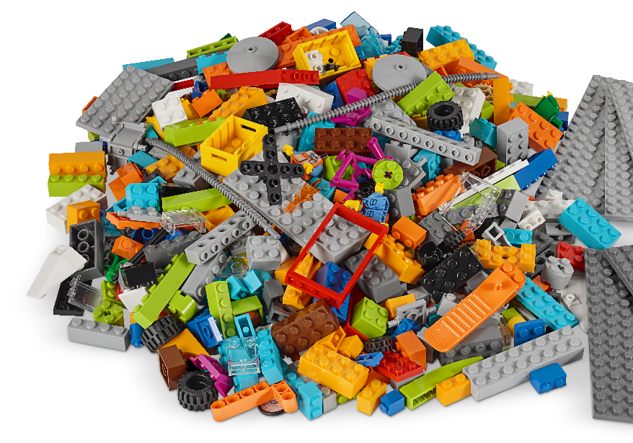
Task 1
Show your team your innovative creation!
Create your team’s designs using the prototyping pieces.
Notes:
Tasks (20 minutes)
Start with Ruby and Jacob’s questions while looking at the mat.
Design how you would transport cargo by air and water.
Show your team your innovative creation!
Create your team’s designs using the prototyping pieces.
Place your solutions on the mat.
Show how they will transport cargo safely from the sorting center to the island and icy area.

Slide 7

Task 1
Place your solutions on the mat.
Show how they will transport cargo safely from the sorting center to the island and icy area.
Notes:
Tasks (20 minutes)
Start with Ruby and Jacob’s questions while looking at the mat.
Design how you would transport cargo by air and water.
Show your team your innovative creation!
Create your team’s designs using the prototyping pieces.
Place your solutions on the mat.
Show how they will transport cargo safely from the sorting center to the island and icy area.

Slide 8


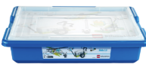
Task 2
You need…
Start the WeDo 2.0 app.
Can you code the sorting center to have a safety flashing light when sorting? Think of how to create a program.
Try out your program!
Notes:
Tasks (20 minutes)
Start the WeDo 2.0 app.
Can you code the sorting center to have a safety flashing light when sorting? Think of how to create a program.
Try out your program!
Challenge
Can you add a different sensor that makes the sorting center safer?
Change the sorting center. Play your new program.

Slide 9
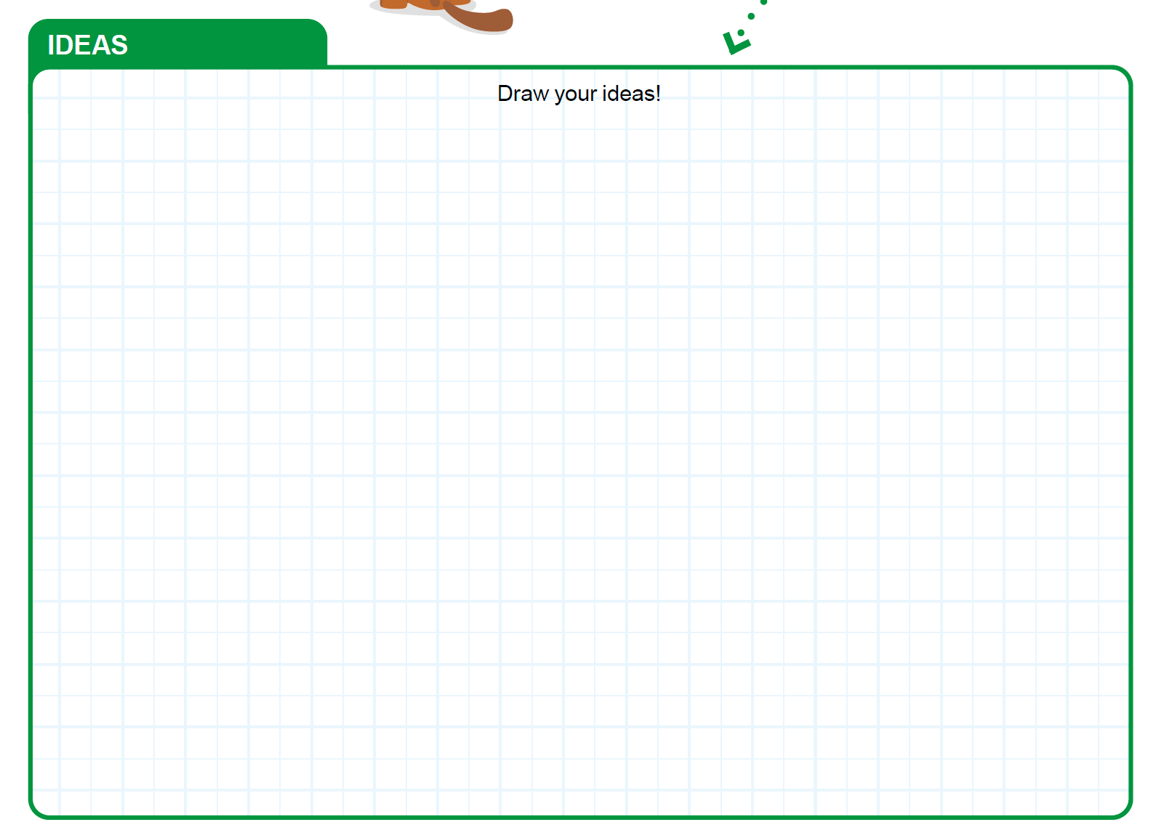
Task 2
Notes:
Tasks (20 minutes)
Start the WeDo 2.0 app.
Can you code the sorting center to have a safety flashing light when sorting? Think of how to create a program.
Try out your program!
Challenge
Can you add a different sensor that makes the sorting center safer?
Change the sorting center. Play your new program.

Slide 10

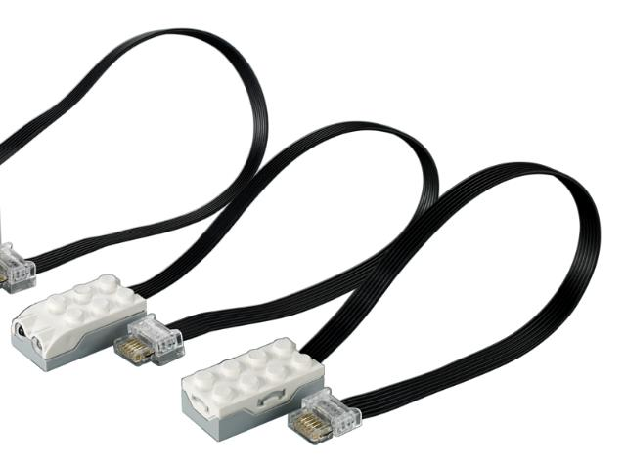
Task 2
Challenge
Can you add a different sensor that makes the sorting center safer?
Change the sorting center. Play your new program.
Notes:
Tasks (20 minutes)
Start the WeDo 2.0 app.
Can you code the sorting center to have a safety flashing light when sorting? Think of how to create a program.
Try out your program!
Challenge
Can you add a different sensor that makes the sorting center safer?
Change the sorting center. Play your new program.

Slide 11

Share
Share what you did in the session.
Show how you safely transported cargo across water.
Point out safety features present on the mat and sorting center.
Explain how you coded a safety light.
How would a
safety specialist do
a safety check on
the sorting center?
Explore ways as a
team!
Notes:
Share (10 minutes)
Have the team:
Share what they did in the session.
Show how they safely transported cargo across water.
Point out safety features present on the mat and sorting center.
Explain how they coded a safety light.

Slide 12
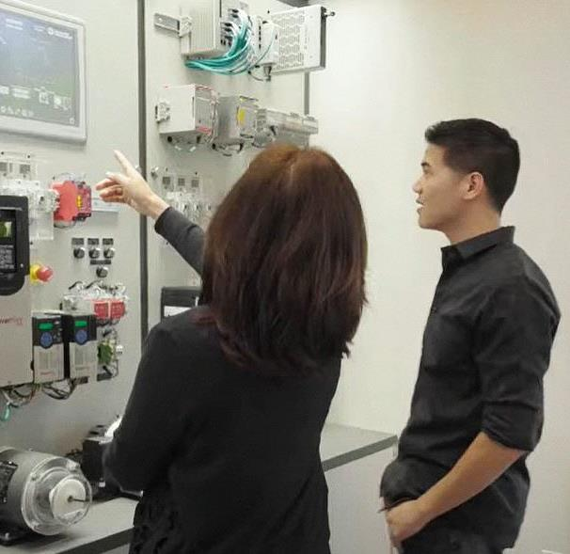
Career Connections
Safety Specialist
Warehouse Worker
Role:
Employs safety practices and ensures compliance.
Notes:
Ask the children to reflect on why it is so important to have safety specialists.

Slide 13

Optional Video:
You may wish to embed a relevant, age-appropriate video for your students here. See the Notes for an example.
Notes:
Choose a relevant, age-appropriate video for your students.
Here are two examples:
Sorting and logistics handling systems at Deutsche Post DHL (Germany): https://youtu.be/3RGupZWkqwI
Behind the scenes at Christmas: Heathrow Worldwide Distribution Centre from Royal Mail (United Kingdom): https://youtu.be/DbtYG3J3MTQ
Since both videos show sorting systems but don’t explicitly discuss safety, you might have your students watch specifically for safety features shown (orange reflective safety vests, emergency stop buttons, warning lights and signs, etc.).

Slide 14
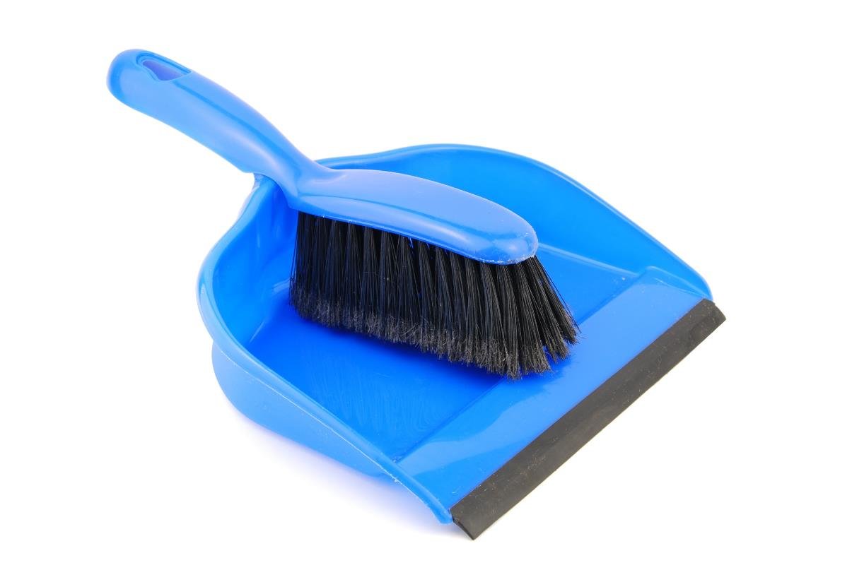
Clean Up
Notes:
You may wish to play a video or song during clean up time Link on GoNoodle: https://family.gonoodle.com/activities/clean-up. Link on YouTube Kids: https://www.youtubekids.com/watch?v=ZJFk87ZsHn0 . Link on Youtube: https://youtu.be/ZJFk87ZsHn0
Cleanup Pointers
• The motorized sorting center should stay assembled, but everything else should be taken apart.
• Check that any pieces used from the LEGO® set are returned to it.

Slide 15
FIRST® and the FIRST® logo are registered trademarks of For Inspiration and Recognition of Science and Technology (FIRST). LEGO® is a registered trademark of the LEGO Group. FIRST® LEGO® League and CARGO CONNECTSM are jointly held trademarks of FIRST and the LEGO Group. All other trademarks are the property of their respective owners. ©2021 FIRST and the LEGO Group. All rights reserved.

